Slide 1
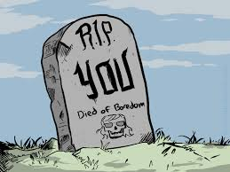
how to not die bored

Slide 2
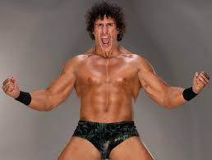
psyche yourself up and pretend

Slide 3
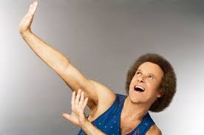
if you act excited, transference.

Slide 4
suggest how to make paper

Slide 5
topic choice
personality
connections
variation

Slide 6
topic choice:
relatable
appropriate
interesting

Slide 7
personality
voice
opinion???
diction
argument

Slide 8
connections
awareness
interest
critical thinking

Slide 9
variation
structure
sentence length
paragraphs

Slide 10
emphasize writing issues, not writer

